Slide 1
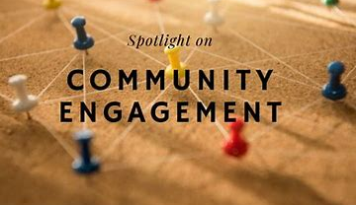
Buildings For Mission
Viv Cooling
Community Engagement
Funding for Church Projects

Slide 2
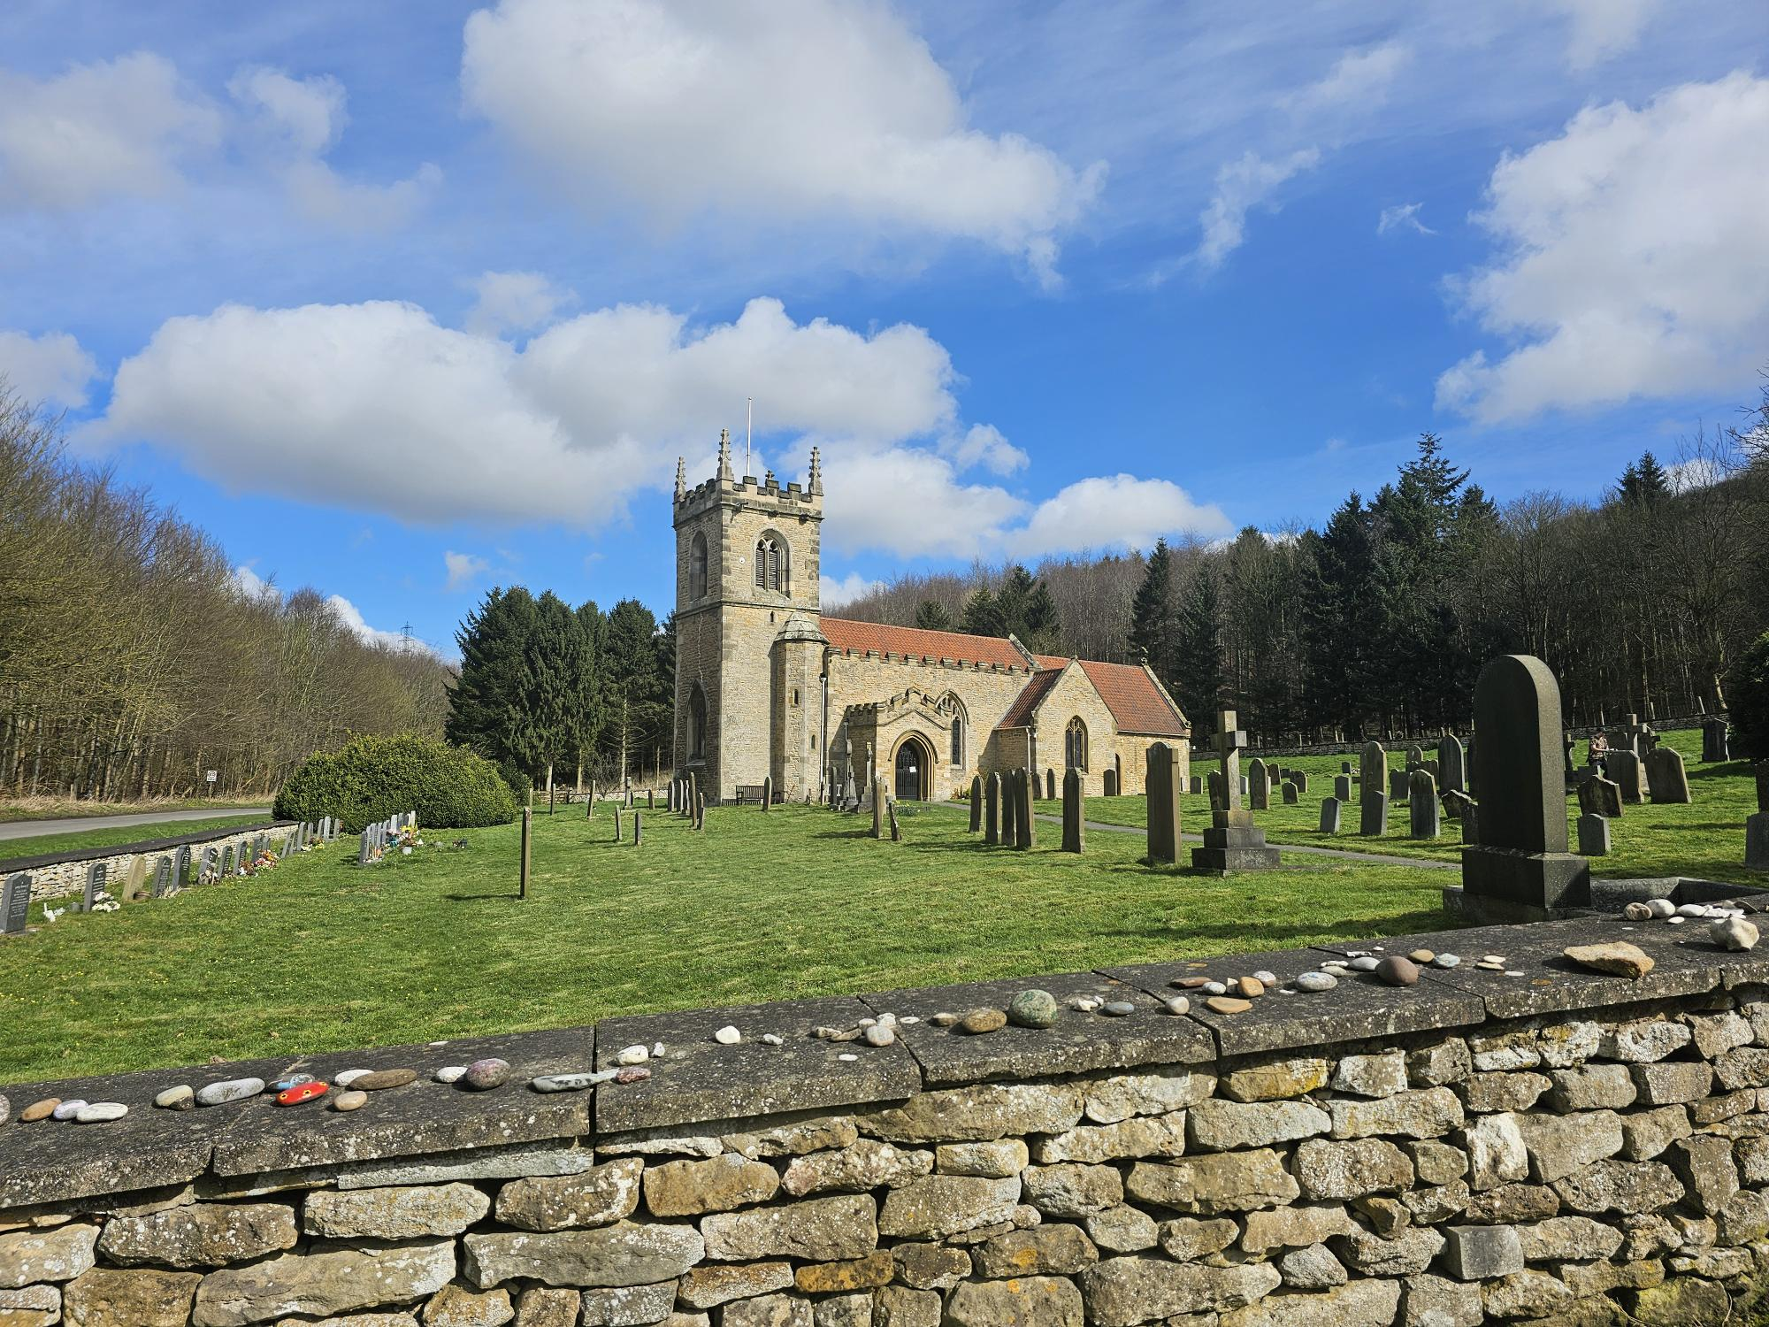
Funding & Community Engagement Support for Parishes
Supporting Parishes through a planned approach:
Strategies for engaging with the wider community
Finding funding and funding strategies
Understanding and completing Trust and Foundation grant processes and applications (case for support).
Working with, and recruiting volunteers, best practice.
Applying for permissions- understanding the faculty process and secular planning system
Working with external organisations and creating partnerships.
Interpreting QI’s and prioritising recommendations for capital projects.

Slide 3
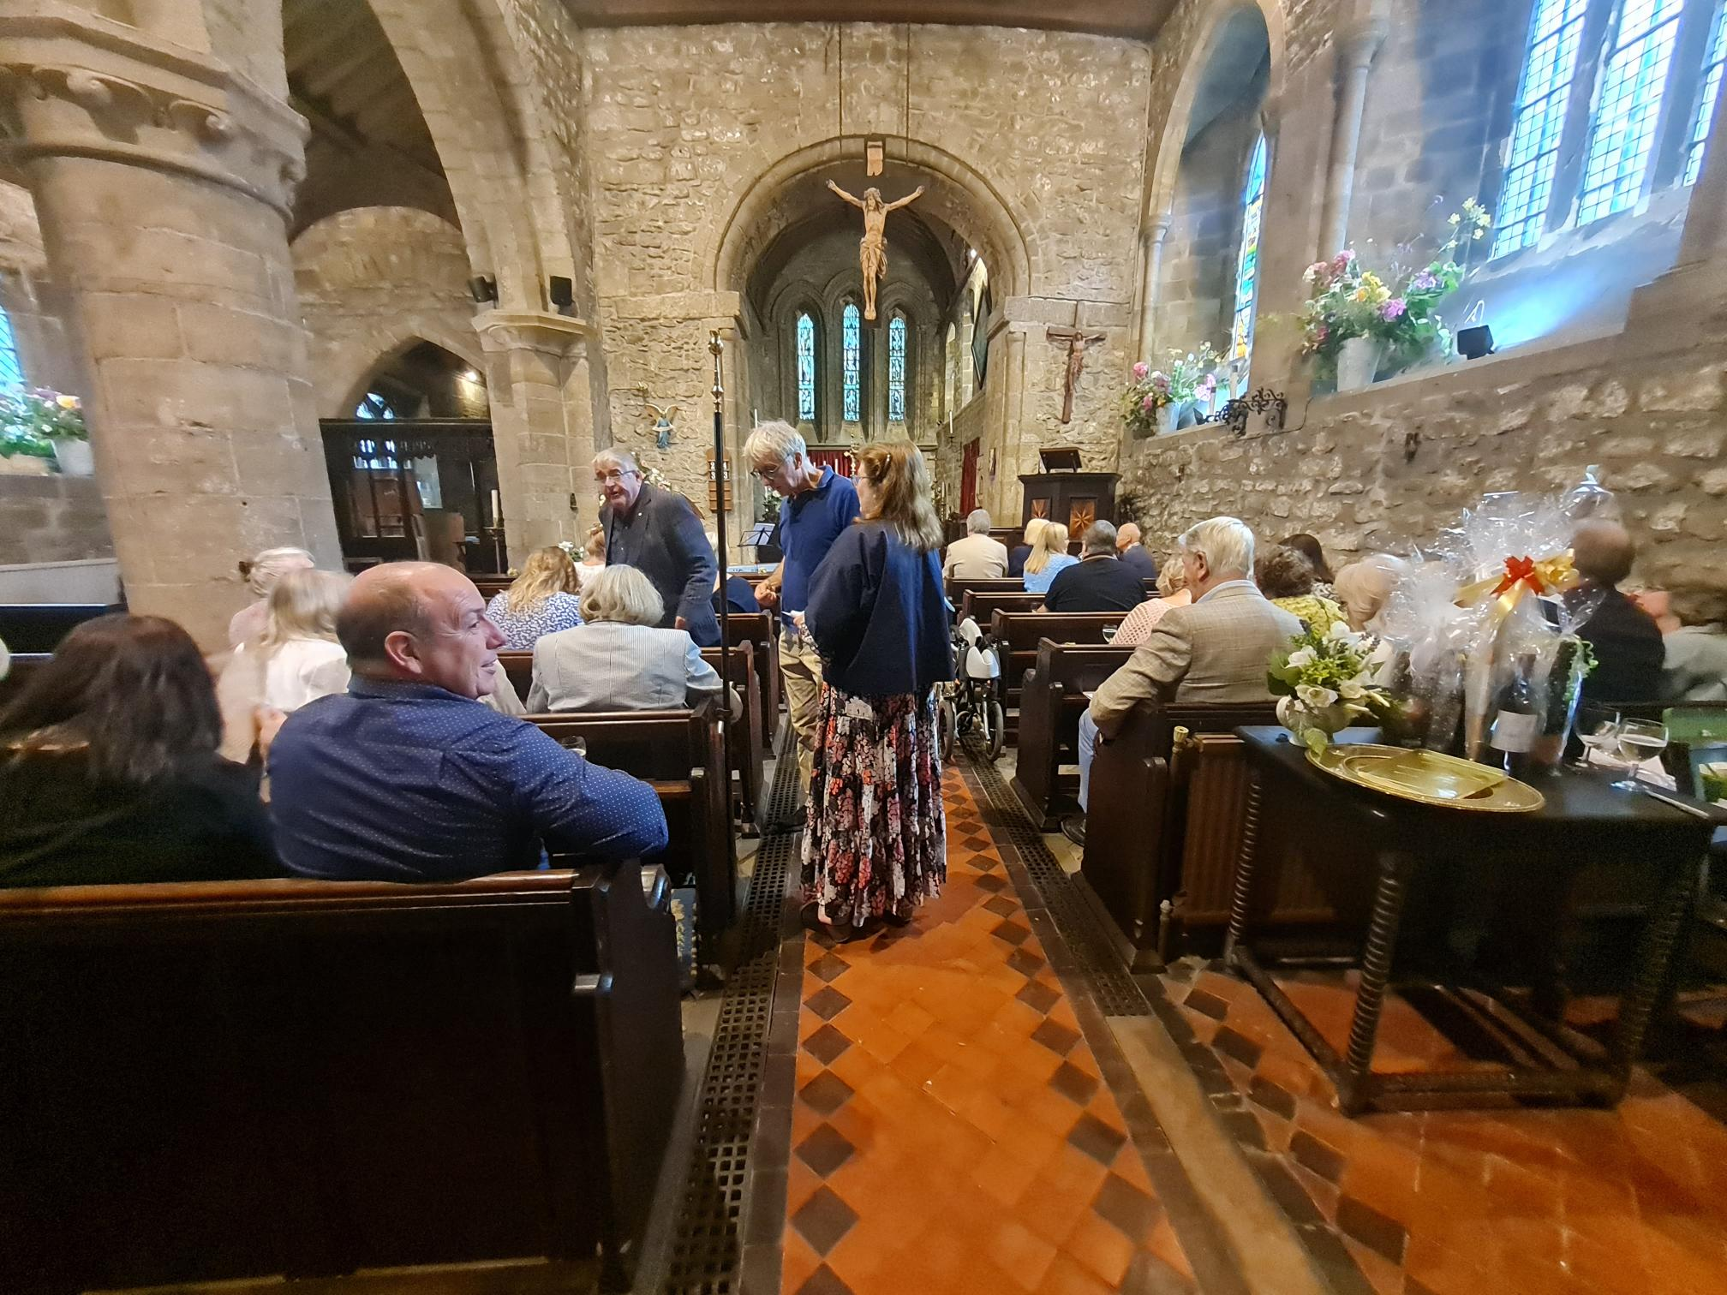
Church buildings, Community Engagement & Funding- the key to success
Work together with people and groups in your wider communities on projects.
Access support and funding from a wide range of support networks and funders.

Slide 4
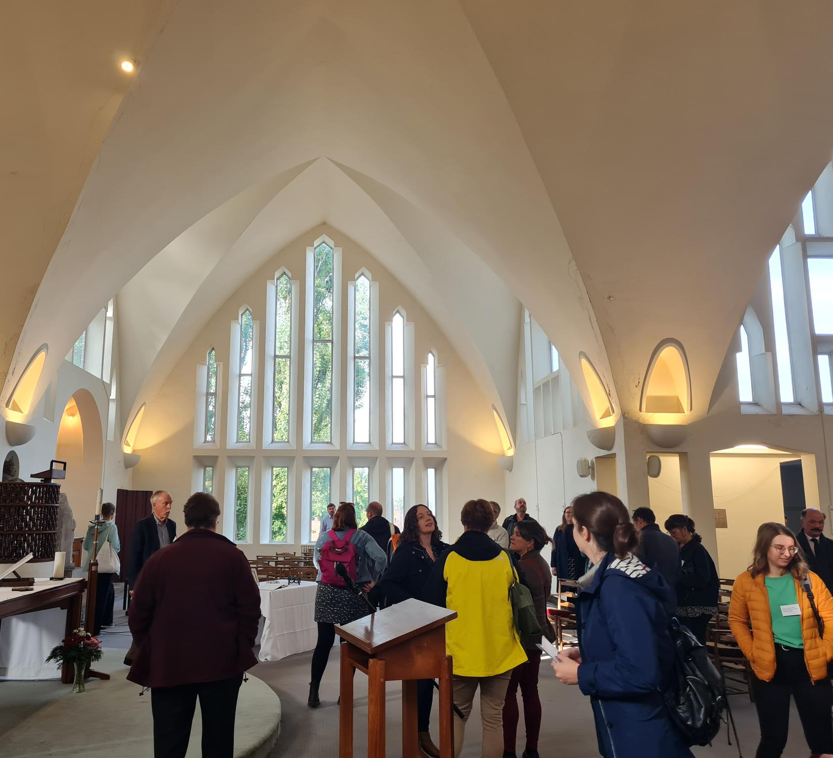
Community Engagement What is it?
Community Engagement is about bringing people together who have a stake or interest in the building for different reasons to share knowledge, experiences and views about the place and its future. This includes thinking about the fabric and facilities of the building, the way it is used and the people that it affects.

Slide 5
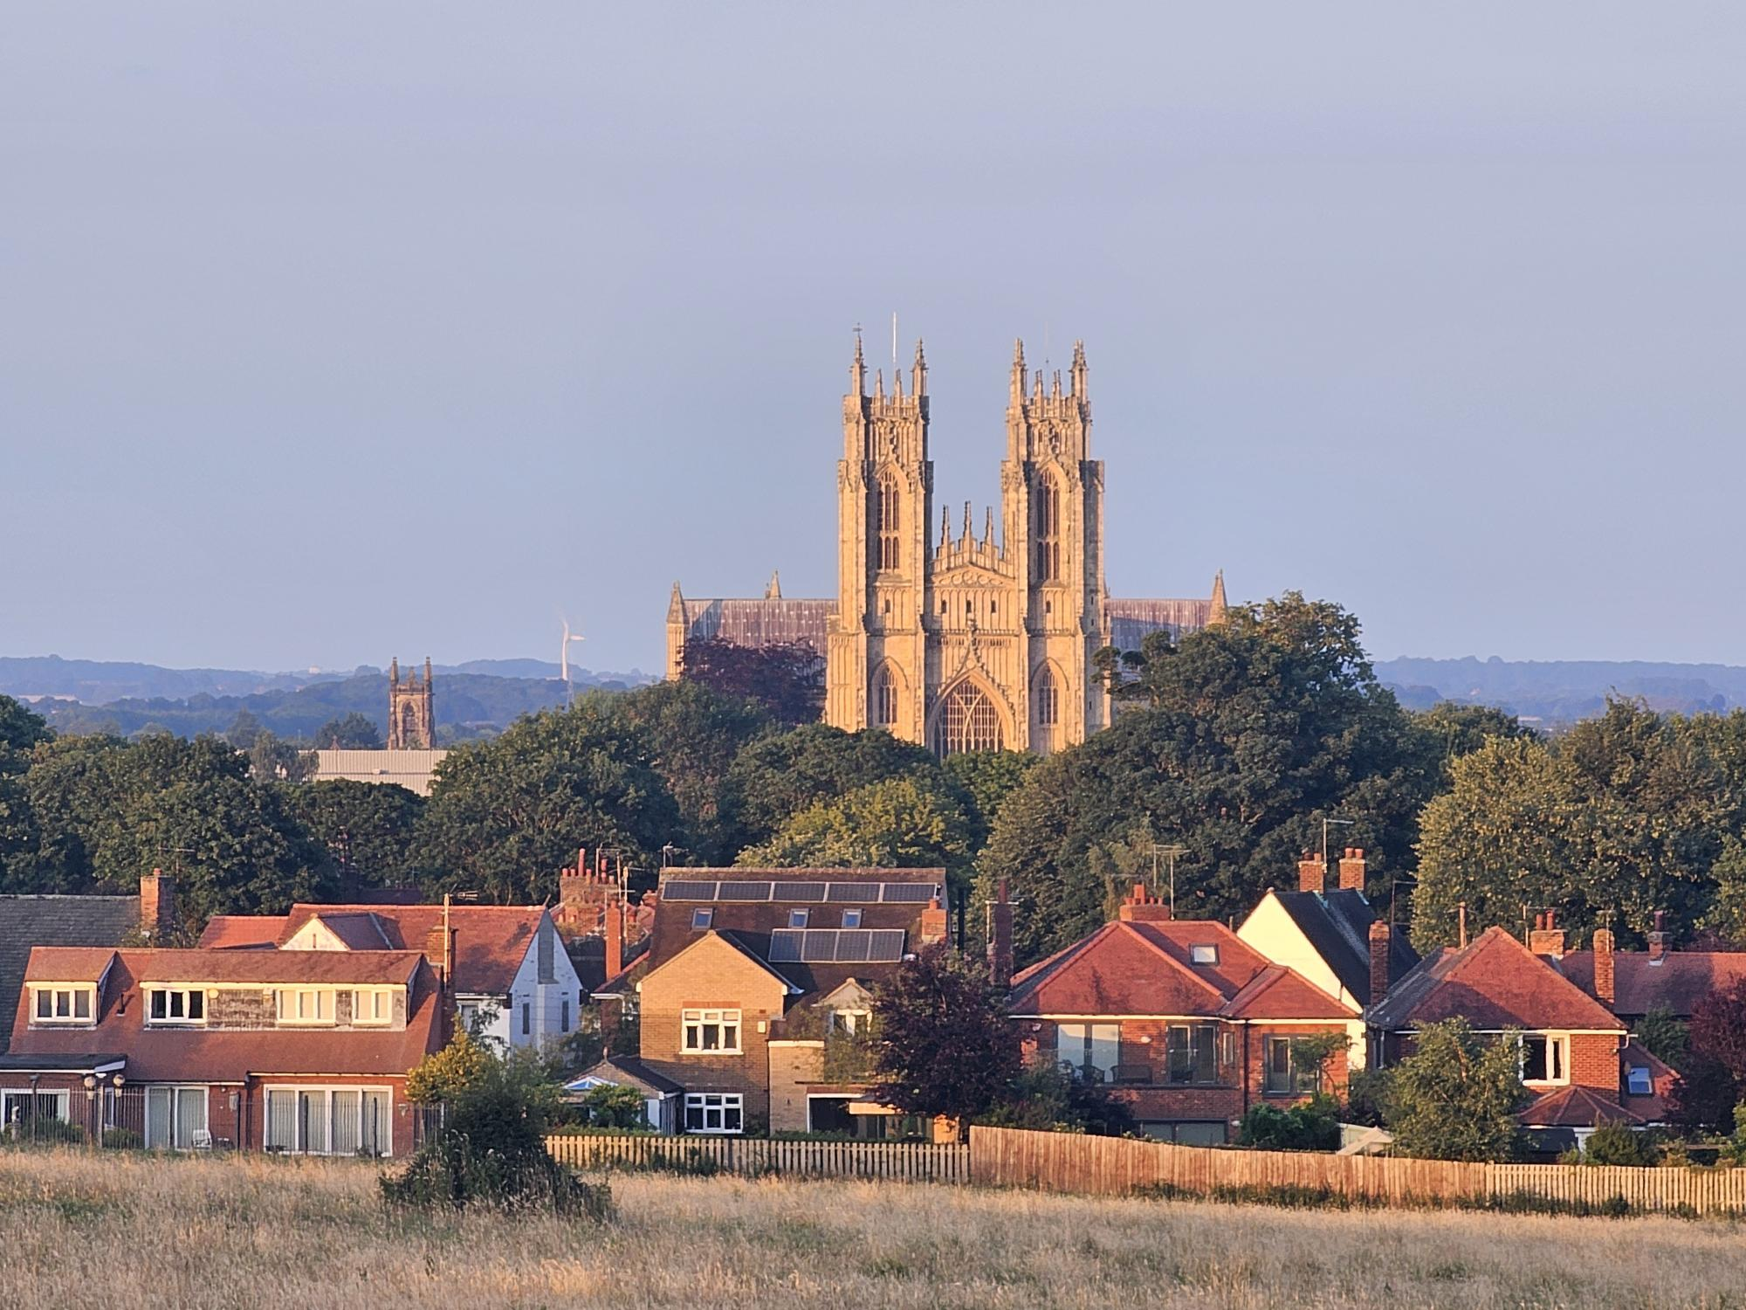
Why do it?
It is a pathway to fulfilling the mission of your church
It supports the church to become viable, relevant and sustainable within the wider local community
It provides evidence required for permissions & grant applications
It can provide avenues to funding and fundraising
It will provide an opportunity for people to help you!

Slide 6
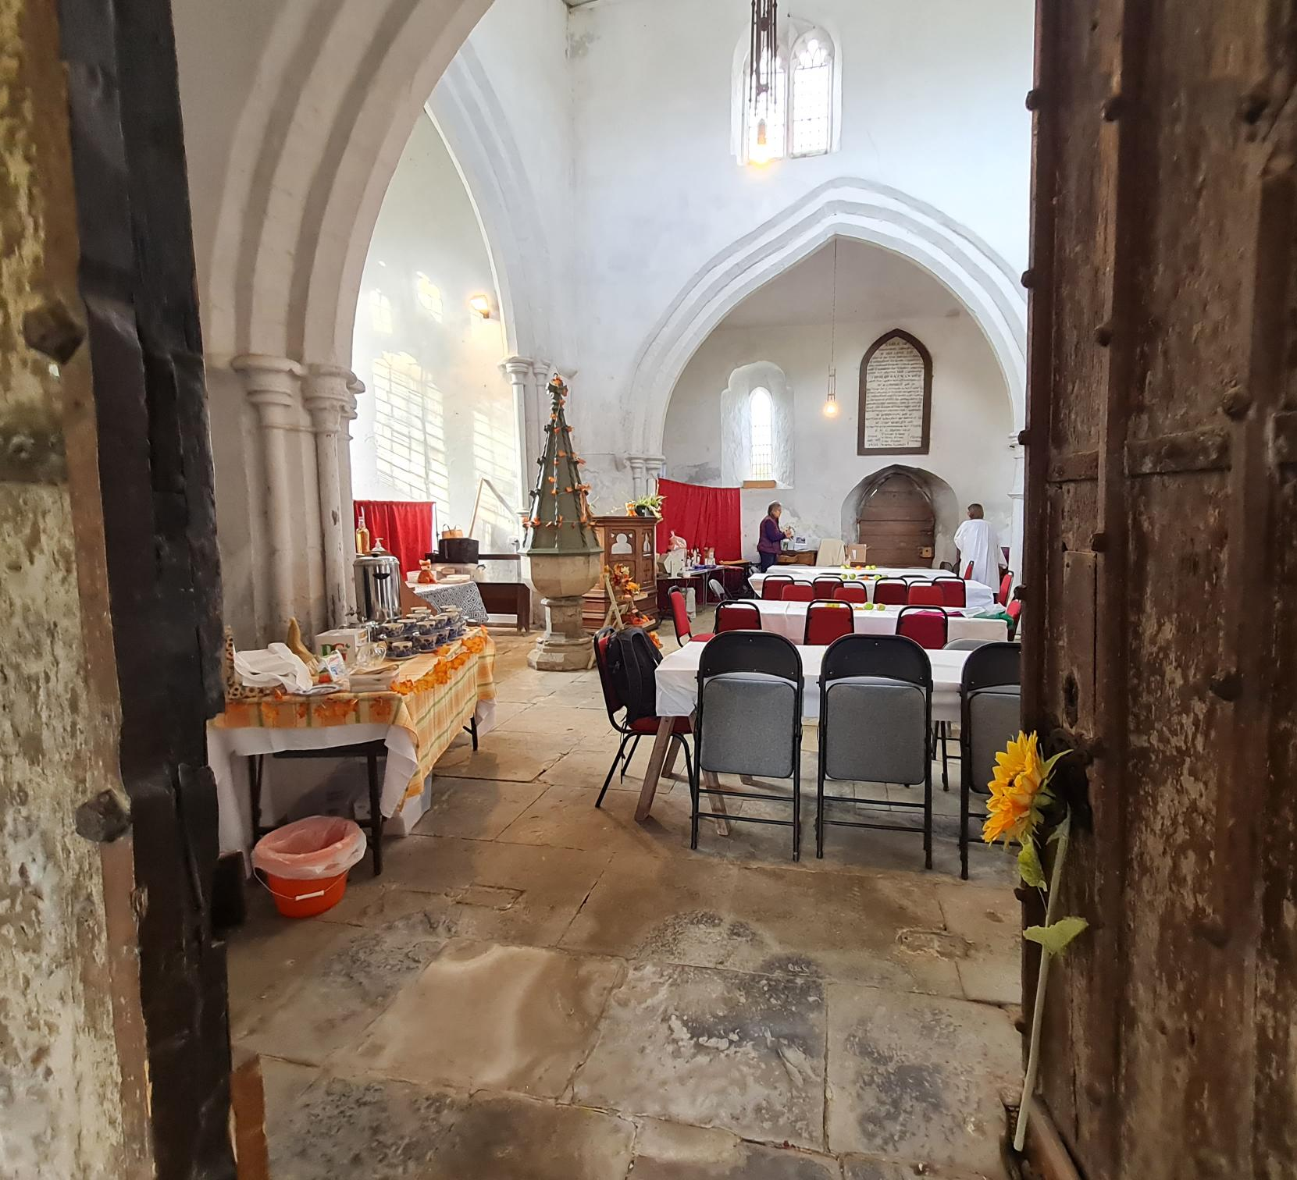
When to do it?
Continuously from the beginning (inception) to the end (delivery).
However, you may want to begin with forming a vision for a project based on the knowledge and information you already have:
about your own strengths, weaknesses and needs (SWOT),
your building, (building audit)
about the resources & needs of the wider community.

Slide 7
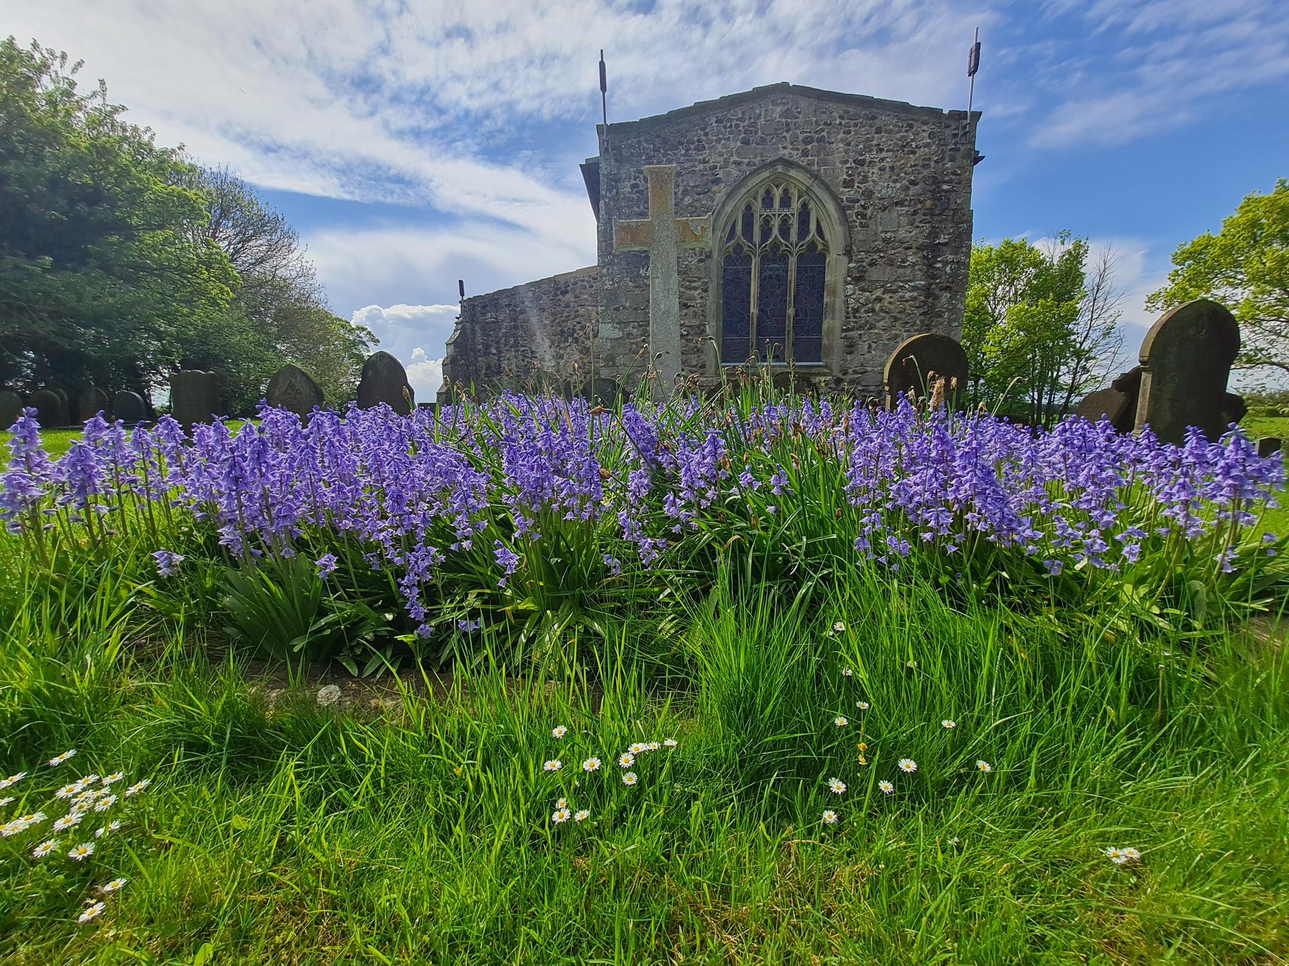
Vision
“Every place of worship has a mission to its community. Each church can seek to articulate this, or develop it, in different ways. The most important task for any parish is to try to work through, honestly, objectively, and prayerfully, what it means to be people of God in their own community, location and circumstances.”
Resources for Rural Places of Worship, Germinate: Arthur Rank Centre

Slide 8
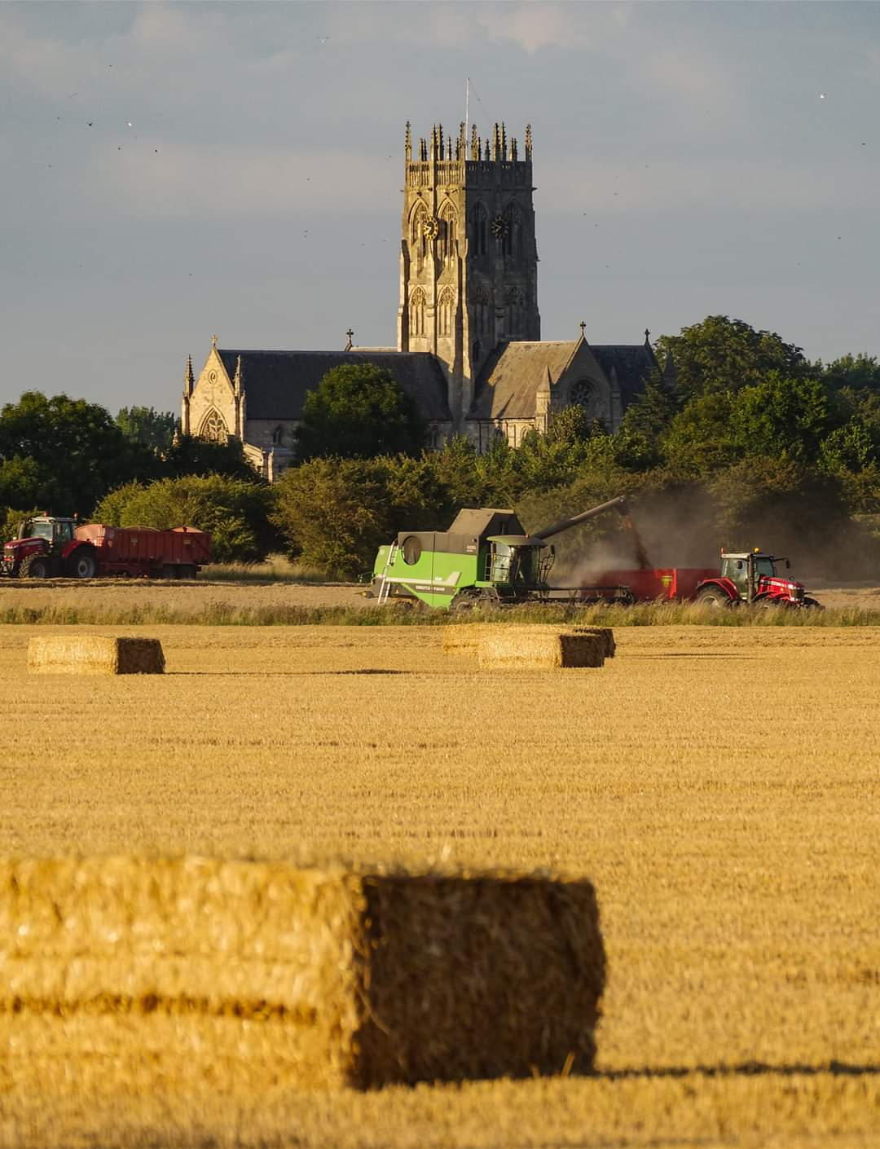
How to Do it
Test Your Vision
Why are changes needed or wanted?
What changes are needed or wanted?
Who needs to be engaged?
How will people be engaged?

Slide 9
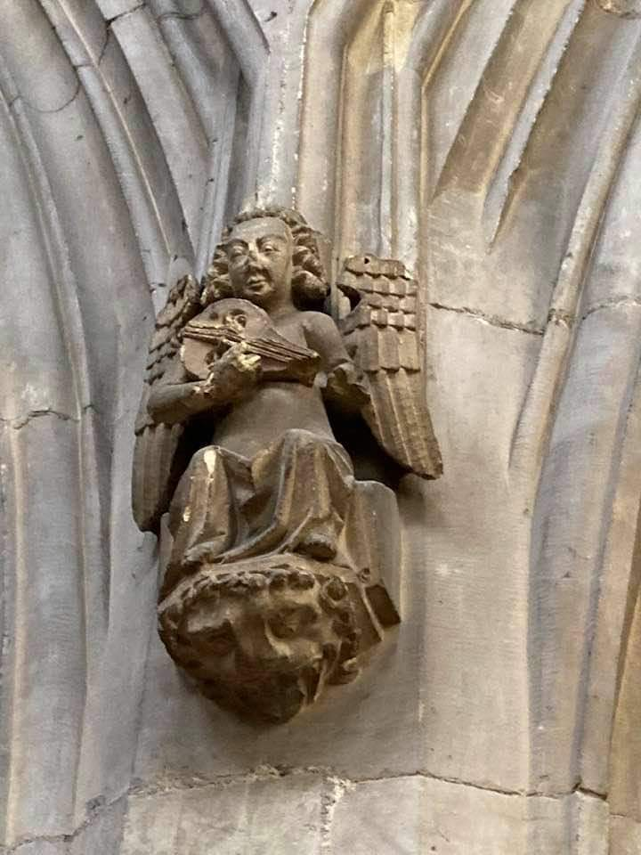
Community Engagement Strategy
Map the local context
Identify the key stakeholders
Decide on the activity and audience

Slide 10
The process of Community Engagement is Key to:
Understanding your building
Significance & (Need)
Understanding your community
(Need)
Informs your Statement of Significance & Need
Provides evidence for permissions (Faculty/ planning)
Provides evidence for grant applications/ Case for support

Slide 12
Funding Your Project
Congregational Giving
Trusts & Foundations
Online Platforms
Legacy Giving
Local Fundraisng
Major Donors
NLHF/NLCF
National Church/Diocesan managed grants
Chartered Institute of Fundraising - Homepage (ciof.org.uk)
Online, text and contactless giving | National Churches Trust
Grants & Fundraising - Diocese of York

Slide 13
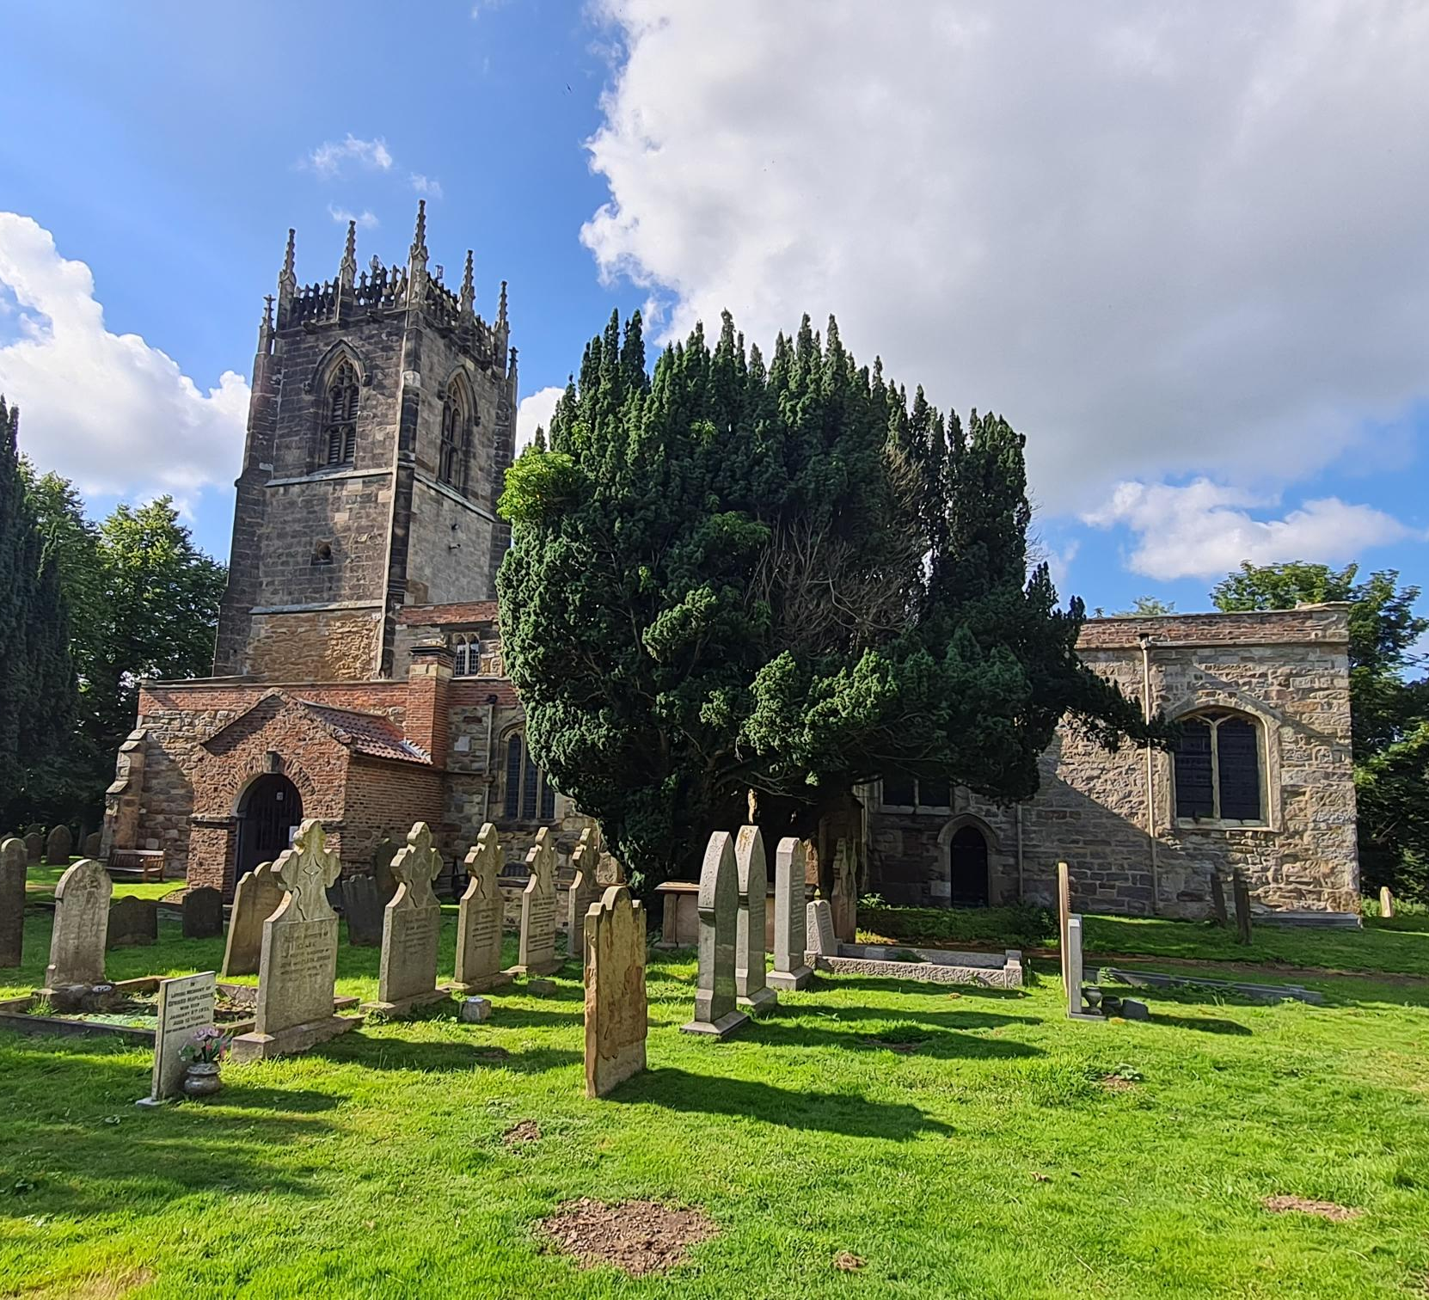
Before you start
Project Plan and Timeline
Case for Support
A realistic budget/accurate costs
Procurement/ Tenders
Permissions in place
Prospects research
'Crossing the Threshold' Toolkit - Diocese of Hereford (anglican.org)

Slide 14
Useful resources:
Project Planning and timeline
Developing and managing church building projects | National Churches Trust
Project plan and risk register template | The National Lottery Heritage Fund
Project toolkits | The Churches Conservation Trust (visitchurches.org.uk)
Writing a case for support
Successful grant applications and building a strong case for support - Benefact Group
Budgeting
Project budget template | The National Lottery Heritage Fund
Procurement of services:
Procurement | The Church of England
Permissions
Faculty Permissions - Diocese of York

Slide 15
Applying to trusts & foundations: Identifying your Prospects
Grants & Fundraising - Diocese of York
ChurchCare grants | The Church of England
General Funds - Community Support North Yorkshire (communitysupportny.org.uk)
Subscribe to Church Grants | Church Grants

Slide 16
Funding Criteria: Writing an Application
Read the Guidance
Research the Funder
Never Assume
The So What Question
What problems does your project solve?
Why is it a problem?
Why is that a problem?
So What?

Slide 17
Tell the story: Case for Support
Tell individual stories about the people who will benefit
What difference will the project make to them?
Focus on the Impact not just the outcome
Remember the, So What? Question
Bring it to life with quotes and photos

Slide 18
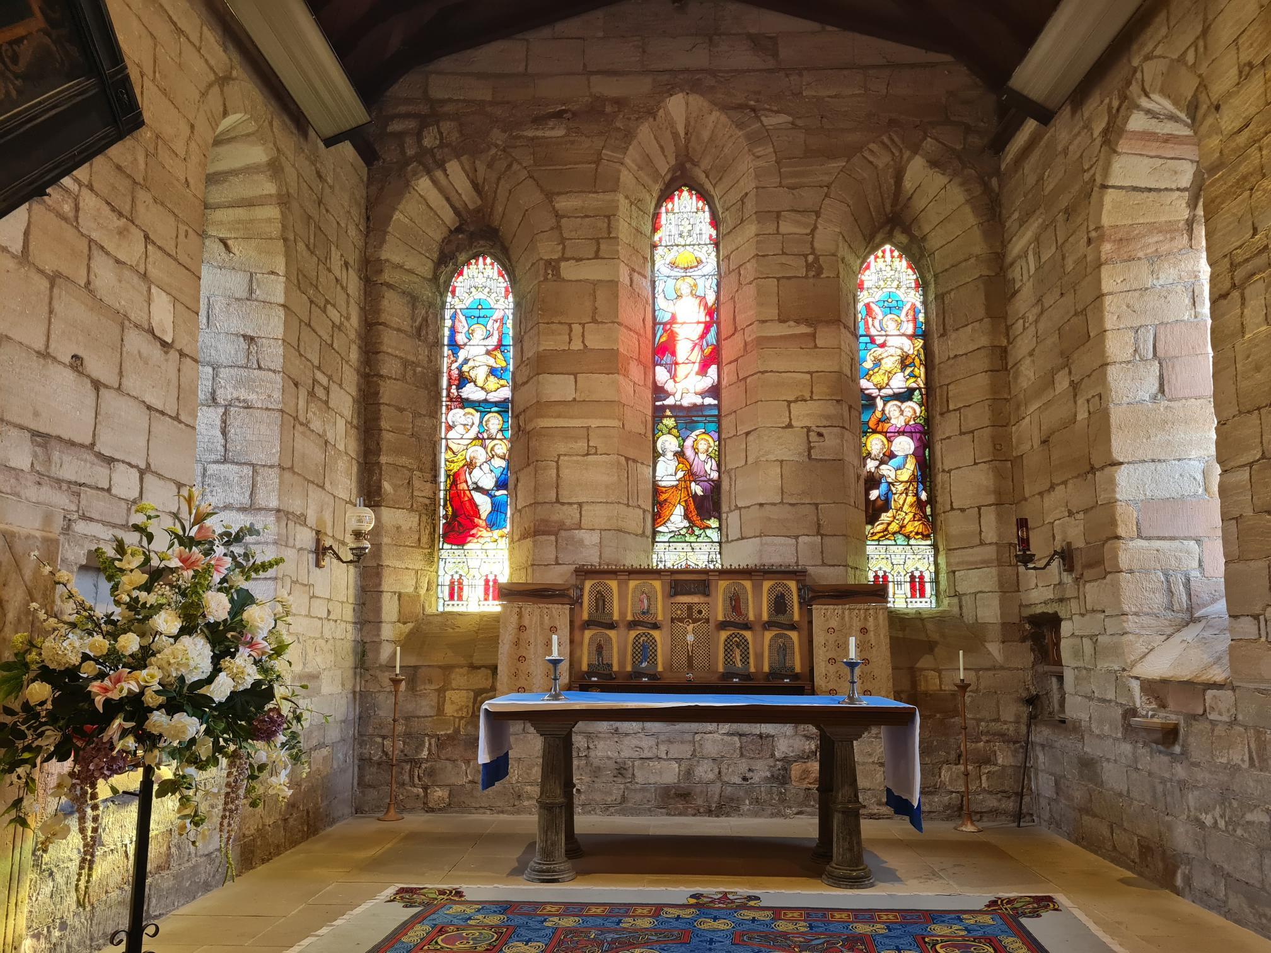
Common Funding Criteria to Consider
100% funding is rare .
Some grant bodies will only fund a small percentage of your overall project costs.
Some funders will only contribute to specific elements of your project
Some funders will allow you to include, in-kind support as part of your contribution.
Volunteers good practice guidance | The National Lottery Heritage Fund

Slide 19
National Lottery Heritage Fund : The time is now!

Slide 20
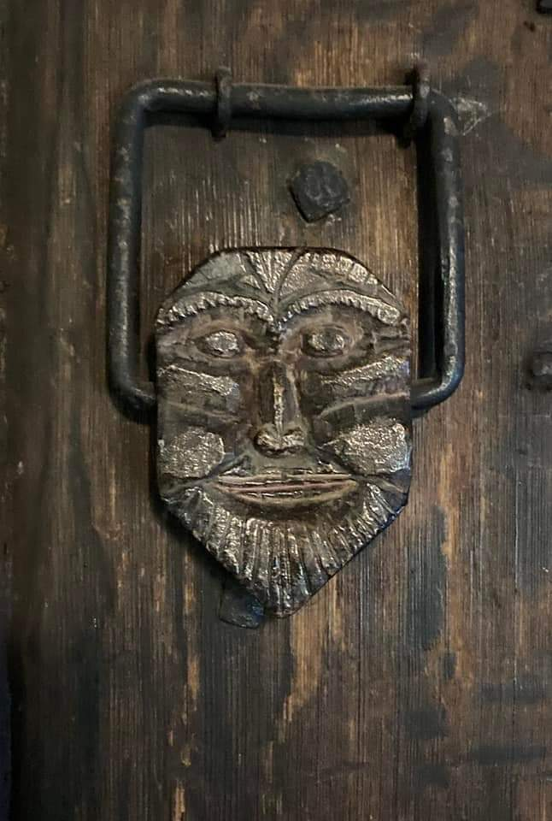
Thank You
Viv Cooling
Funding & Community Engagement Officer
Viv.cooling@yorkdiocese.org
Tel: 07985 241241

