Slide 1
Net zero carbon – the faculty system
Catherine Copp
DAC Secretary
Feb 2020 – General Synod set challenge to reach net zero carbon across our parishes, cathedrals, dioceses and schools by 2030.
The ROUTEMAP, approved by General Synod in July 2022, is a plan for how we can reach that target.
https://www.churchofengland.org/resources/net-zero-carbon-routemap

Slide 2
WHAT DOES THE ROUTEMAP REQUIRE OF YOU?
Milestones By end 2023
10% of churches be registered with Eco Church and 5% to be awarded at least Bronze Eco Church
90%+ completion rate for the Energy Footprint Tool
Notes:
EFT information is vital because it will inform the diocesan strategy for reaching net zero carbon. If we don’t know the level of our carbon emissions across the diocese we don’t know how much work we need to do to reduce them, nor will we be able to gauge the level of success achieved.

Slide 3
By end 2024
At contract renewal, switch to 100% green electricity tariff (or to green gas tariff if still have gas heating)
By end 2025
All churches to have energy-efficient lighting installed throughout, with timers and light and motion sensors where appropriate
No new oil boilers installed after this date (subject to govt action to connect rural communities to grid)
By end 2026
40% of churches to be registered with Eco Church, 30% of these to have an award and at least 30% of these to be awarded Silver Eco Church award or higher.
By end 2027
From 2022, top 20% of energy-consuming churches to begin to develop a Net Zero Carbon Action Plan, finalised no later than 2027, to include, as a minimum:
low-carbon heating options to replace fossil-fuel heating at end-of-life, such as heat pumps or far infra-red heating panels
Heating Resilience Plan (considering how to manage heat should existing system fail, to avoid needing quick like-for-like fossil-fuel replacement)
Notes:
Whilst the requirement for an Action Plan relates to our largest churches (generally our biggest carbon emitters) it is wise for ALL churches to look ahead and have a Heating Resilience Plan for when their fossil fuel boiler fails. Think ahead and be ready to take action so you won’t be without heating for any longer than necessary.

Slide 4
HOW CAN YOU ACHIEVE THIS?
1. EASY WINS
2. ENERGY EFFICIENT LIGHTING
3. ENERGY EFFICIENT HEATING
Faculty Permission | What it covers
List A | Minor works which need no consultation/permission - immediate
List B | Works which need written approval from your Archdeacon – 2 to 3 days
Faculty | Works which need a faculty granted by the Chancellor – 2 to 3 months
Notes:
Lists A and B can be found on this page of the diocesan website: https://dioceseofyork.org.uk/support/for-churches/church-buildings/faculty-permissions/

Slide 5
1. EASY WINS
List A includes:
Draught proofing an external door or window
Works of adaptation (not substantial addition or replacement but including rewiring) to existing… electrical installations. [Could include installation of a smart meter]
Installation in churchyard of an upstand with electrical outlet mounted on it for recharging electric vehicle, where church is not a listed building
List B includes:
Installation of roof insulation in church or church hall which is not a listed building
Mounting of electrical outlet for recharging electric vehicle on external wall of church or church hall which is not a listed building
Installation in churchyard of an upstand with electrical outlet mounted on it for recharging electric vehicle, where church is a listed building
Introduction of stands for bicycles

Slide 6
2. ENERGY EFFICIENT LIGHTING
List A includes:
Works of adaptation (not substantial addition or replacement but including rewiring) to existing… lighting installations. [Could include addition of timers and light and motion sensors]
List B includes:
Replacement of light fittings with fittings suitable for low-energy lamps (LEDs)
(NB does not cover entire new lighting schemes)

Slide 7
3. ENERGY EFFICIENT HEATING
List A includes:
Replacement of boiler in same location and utilising an existing non-fossil fuel supply
Works of adaptation (not substantial addition or replacement) to existing … heating systems (including replacement of control equipment and insulation of pipes in boiler room and ancillary service areas) [so could include adding timer to heating controls]
List B includes:
Replacement of boiler in same/substantially same location and utilising (a) non-fossil fuel supply in place of fossil fuel supply, or (b) different non-fossil fuel supply
Installation of photovoltaic panels on church or church hall which is not a listed building or in conservation area
Introduction of electrical heating appliance not forming part of a heating system
Installation of electrical heating system for attachment to pews made in or after 1850 and which are not of historic interest

Slide 8
FOSSIL FUEL BOILERS
Any fossil fuel boiler now requires a Faculty
Faculty Jurisdiction Rules amended in 2022: churches must have due regard to CBC’s advice on Net Zero Carbon NB: churches not prevented from having fossil fuel boilers, but must justify installation in light of net zero guidance
Notes:
The section headed ‘Faculty changes (2022) and key guidance’ can be found on this page of the CofE website, with links to all of the guidance documents listed above: https://www.churchofengland.org/resources/churchcare/net-zero-carbon-church

Slide 9
Heating needs
The 5Ws:
WHO are you heating?
WHAT type of event ?
WHEN are you heating them?
WHERE are you heating them?
WHICH parts of the building fabric, interiors, or objects need special care?
https://www.churchofengland.org/sites/default/files/2023-05/Heating_checklist.pdf
Notes:
The Heating Checklist can be found here: https://www.churchofengland.org/sites/default/files/2023-05/Heating_checklist.pdf Consider the 5Ws and draw up a plan to help you picture and clarify your heating needs, both how to keep people comfortable and the building fabric protected. It is not about ‘heating the church’ – it’s about comfort levels and fabric conservation and each might need a different approach. Often a combination of approaches might be the best way forward, such as pew heaters for people’s comfort and low level background heating on all the time to protect the building fabric. Each building and each congregation will have different needs which is why the 5Ws are a good place to start your planning.

Slide 10
Having due regard….
https://www.churchofengland.org/sites/default/files/2023-05/heating_options-appraisal.pdf
Notes:
Heating Options Appraisals note… helpful chart shows types of energy source and types of heating emitters for each source. When you are applying for a faculty for a fossil fuel heating system you have to show that you have had due regard to the CBC’s net zero guidance. A simple way to do that is to take that heating options chart and start by eliminating all those which are irrelevant to your church … e.g. we don’t have fixed pews so can’t have pew heaters, we don’t have 3-phase electricity so we can’t have electric heating, we don’t have sufficient burial free ground around church for ground source heat pump, we have looked at solar panels but our architect says church roof not strong enough to bear weight, the planning authority say they would refuse any planning application for air source heat pumps because church is so close to residential buildings, we can’t have a Biomass boiler because we’re in an Air Quality Management Area etc etc
Then put all that into an explanatory note to support your faculty petition for a new gas or oil boiler. Cost is one aspect which the Chancellor will take into account. When the DAC considers your faculty petition for a new gas/oil boiler and gives its recommendation (or otherwise) to the Chancellor, we have to indicate whether or not, in our opinion, your consideration of the net zero guidance is adequate. So there’s no getting around it. You have to demonstrate why a fossil fuel boiler is your only realistic option.

Slide 11
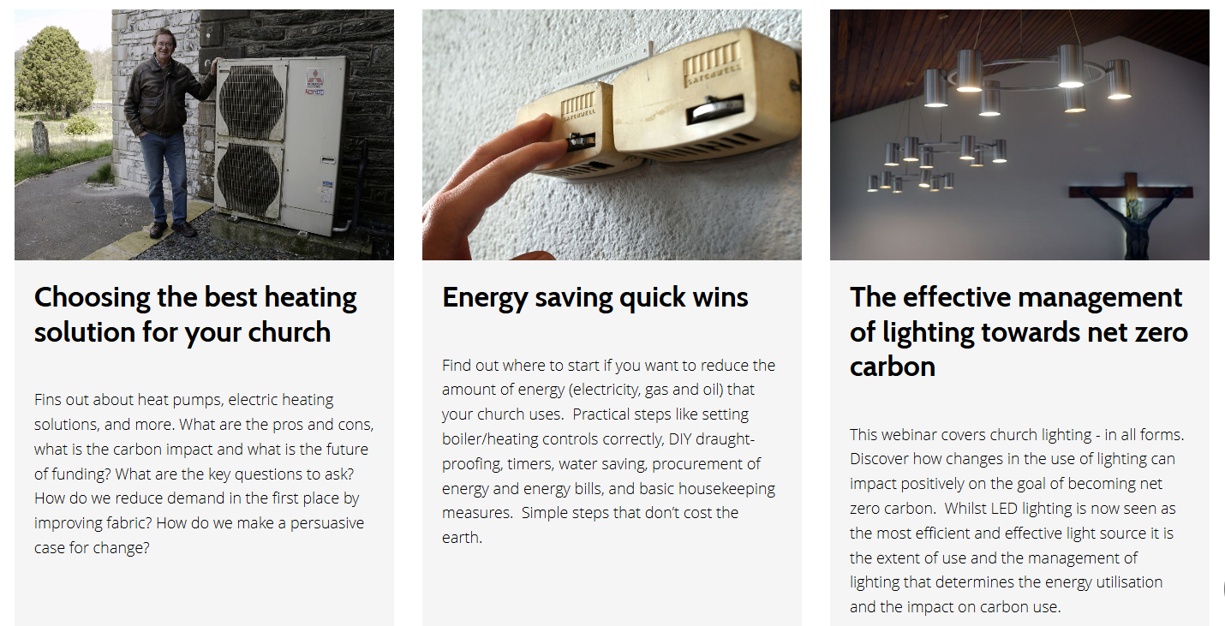
RESOURCES …
https://www.churchofengland.org/about/environment-and-climate-change/webinars-getting-net-zero-carbon

Slide 12
Tobit Curteis

Slide 13
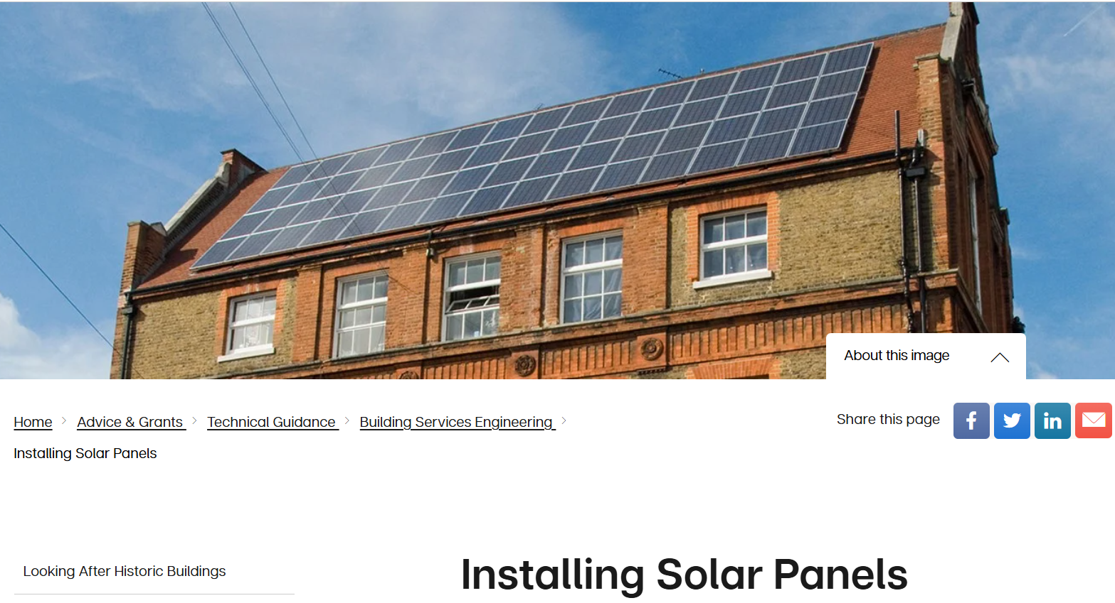
Solar (PV) Panels
https://www.churchofengland.org/sites/default/files/2021-09/Solar_Panels_and_Faculty_Guidance_0.pdf
https://historicengland.org.uk/advice/technical-advice/building-services-engineering/installing-photovoltaics/

Slide 14
Notes:
You CAN have solar panels on a listed church building (even Grade I, such as Roos All Saints above) but it depends on factors including age, significance, location, visibility etc. It is also possible to store off-peak electricity in a battery storage system without having solar panels. Might be worth looking into if the church is used day and night throughout the week then battery storage would be a good investment as they would be able to run ‘off-grid’ for longer. Look at Duracell website: https://www.duracellenergy.com/storing-off-peak-electricity-in-a-battery-storage-system/

Slide 15
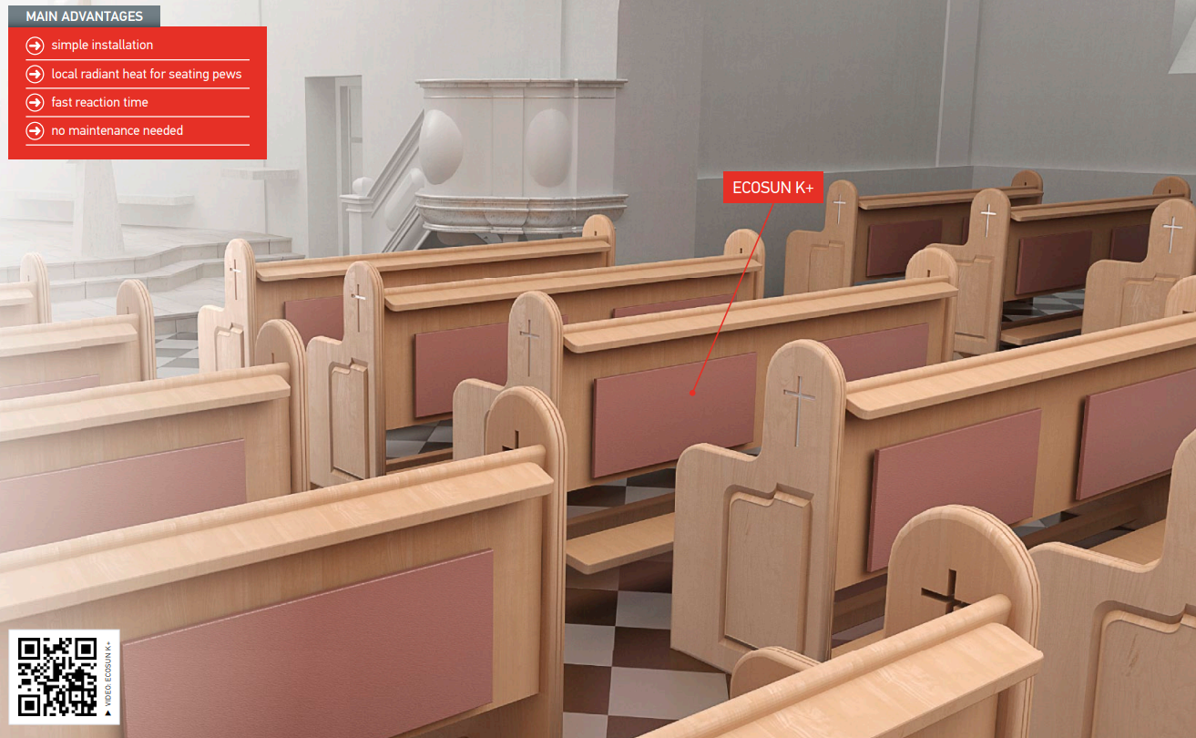
pew heaters
https://www.fenixgroup.cz/en/electric-heating-churches-and-places-cultural-heritage
https://www.bnthermic.co.uk/applications/church/

Slide 16
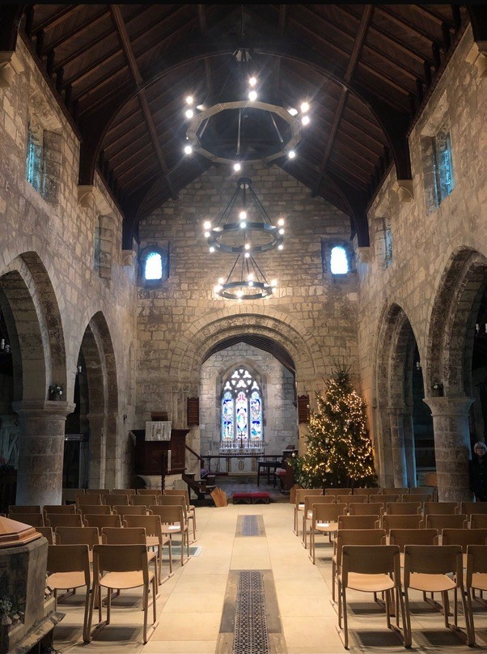
Halo heaters
Herschel church heating solutions

Slide 17
https://www.churchofengland.org/about/environment-and-climate-change/fundraising-for-net-zero-carbon

Slide 18
https://dioceseofyork.org.uk/support/for-churches/church-buildings/grants-fundraising/
Notes:
The MRIG scheme grant has now been increased to £20k (£24k if your church is not a listed building). Make sure you get the basics sorted – keep gutters and drains clear and flowing, slipped slates re-fixed, repointing carried out i.e. keeping the building wind and watertight with heads an feet dry – before looking at new heating schemes.

Slide 19
DAC lighting and heating Advisers - visits
If you need advice on a new heating/lighting scheme and you think that a visit from a DAC Adviser would be helpful, please contact Catherine Copp
Catherine Copp
catherine.copp@yorkdiocese.org

